Slide 1

Testing of Online Examination Portal
G.S.Geetha
192011292
CSA3731-SOFTWARE TESTING FOR
ANDROID Applications
31/01/2023

Slide 2

Objective:
Test the online examination portal by implementing ->positive and negative testcases .
->functionality checking using Appium software.

Slide 3
Abstract:
Online Examination Portal includes acute details about objectives of the structure, different logins, portal action model, primary structure requirements, schedule of the examination , and eventually surveying mechanisms for the entire portal structure.
Online Examination Conducting Portal is very beneficial for Educational Institute's to formulate an entire exam, saving time to check the papers and concoct mark sheets.
Finally, the required testing process is carried out to the online examination portal to check all the positive and negative scenarios of the given application.

Slide 4

Proposed SYSTEM:-
To develop the testing environment , appium software is installed in the windows. And IntelliJ is an another software, a JDK , which provides us an environment to run java programs.
For visualization , android studio is installed.
The functionalities that are involved in this online examination system involves below :
->student data management
->login details

Slide 5
->exam schedule
->request for hall ticket.
->generate hall ticket
->seating plan for students
->add new tests or exam updates.
->calculate marks
->exam results
->evaluate grade

Slide 6
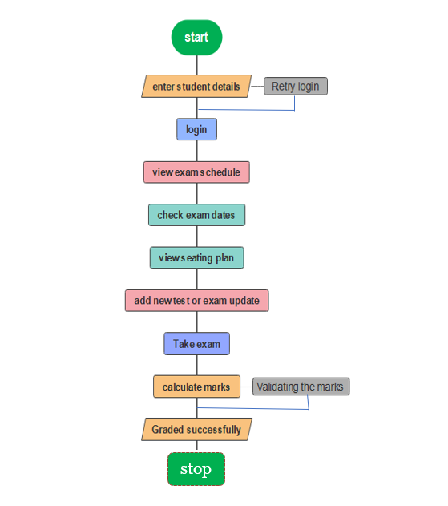
Flow Chart
no
yes

Slide 7
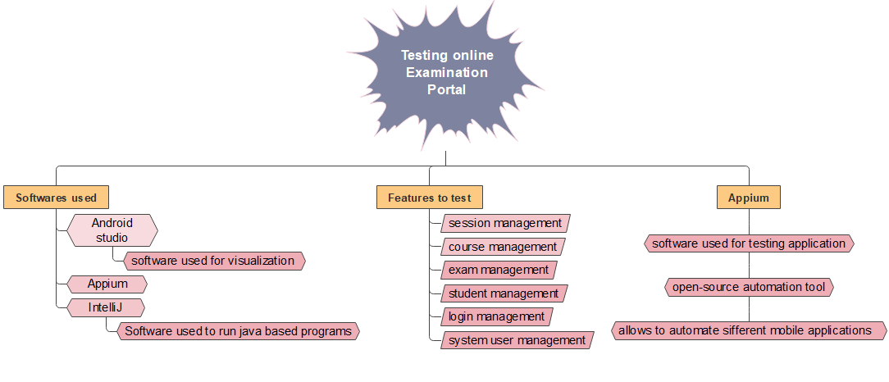
Concept mapping

Slide 8
test cases
Login id
Verify the password
Test the exam schedule
Test the exam dates
Test the seating plan
Test the schedule update.
Test the hall ticket generation.
Verify faculties available
Verify exam pattern
Test the end results.

Slide 9



APP TOOLS
APPIUM
INTELLIJ
ANDROID STUDIO

Slide 10
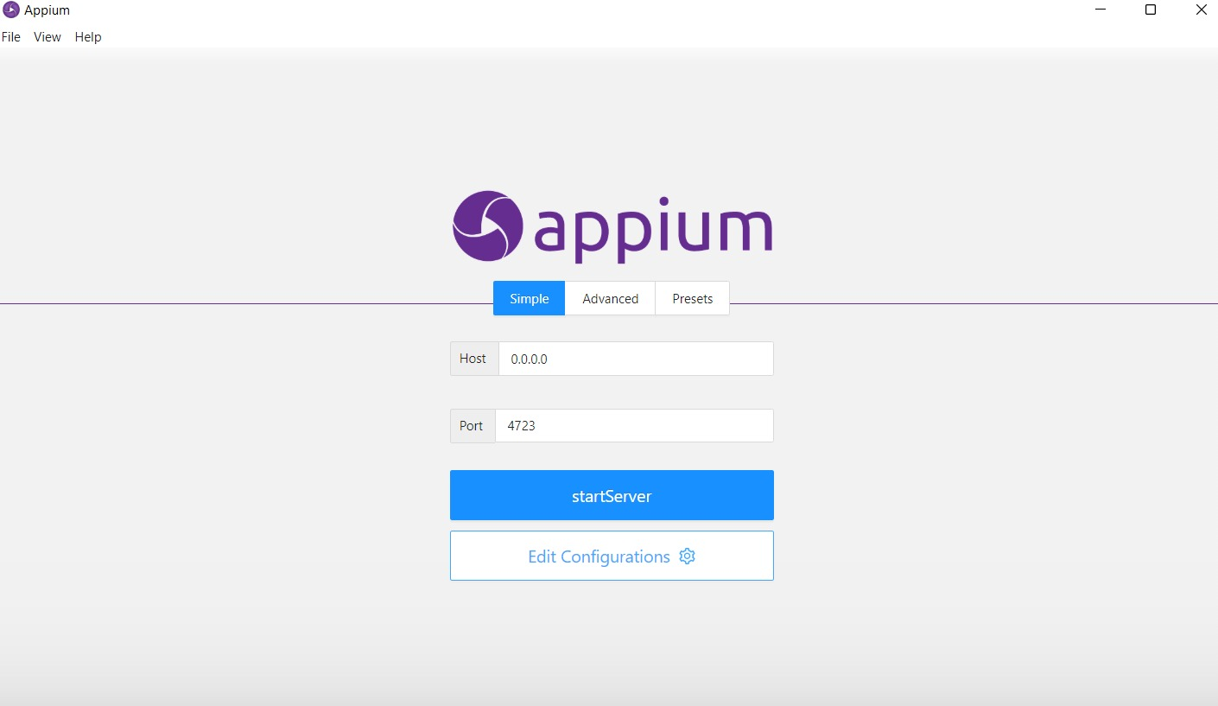
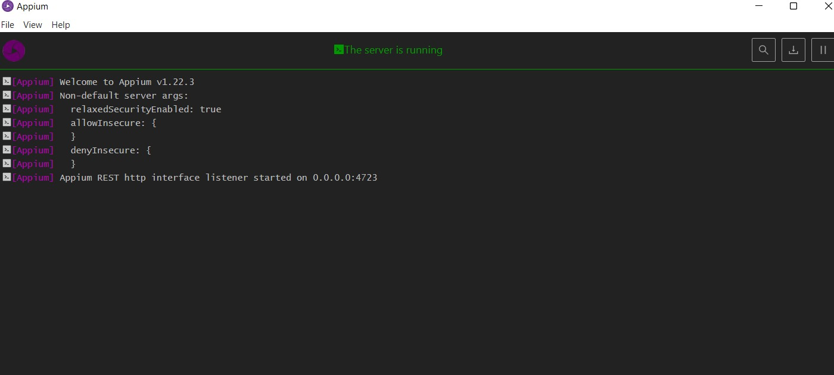
IMPLEMENTATION OF TESTING
APPIUM
ANDROID STUDIO

Slide 11
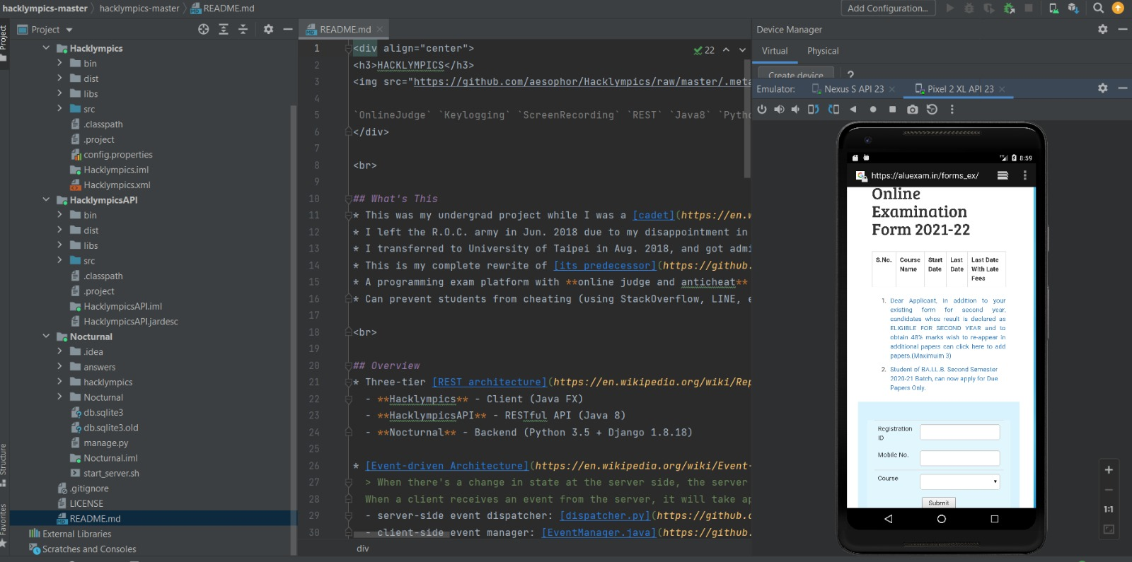
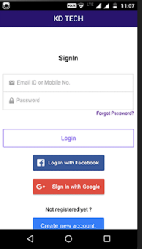
ANDROID STUDIO

Slide 12
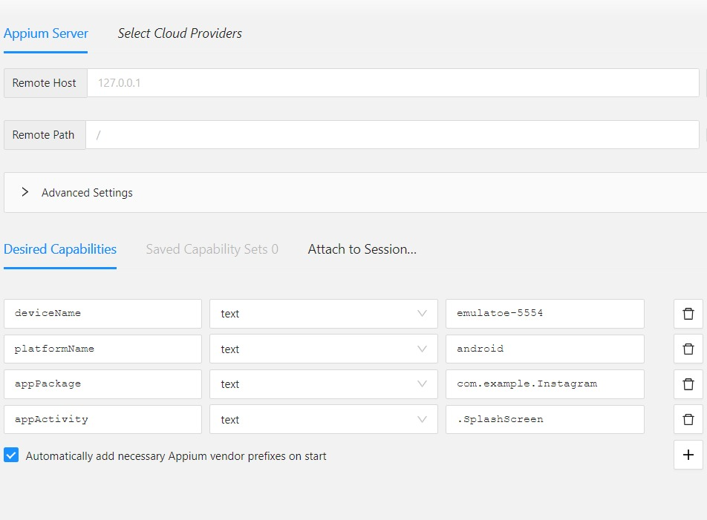
IMPLEMENTATION OF TESTING

Slide 13
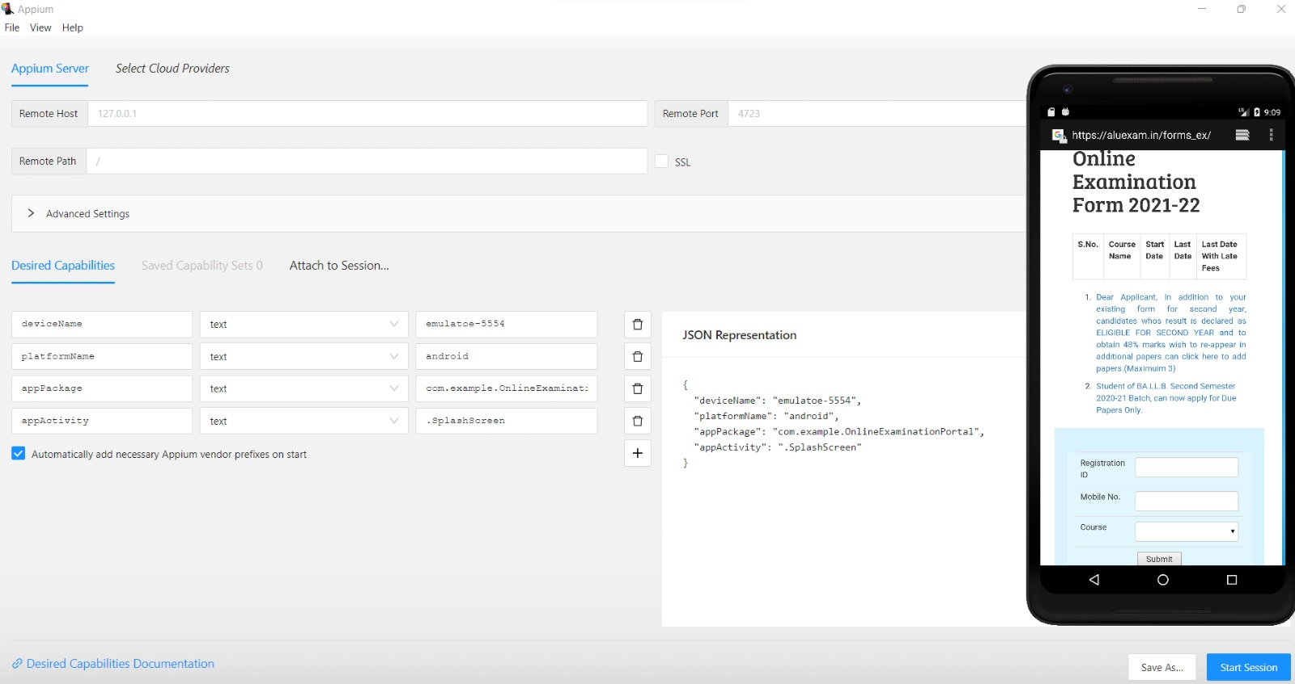
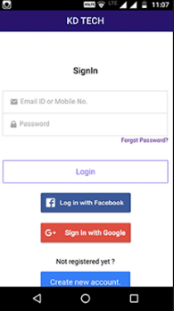
TESTING OUTPUTS

Slide 14
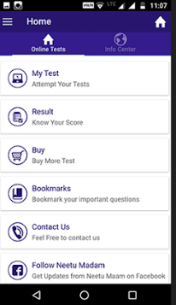
TESTING OUTPUTS

Slide 15

Test case outcome
TEST CASES | POSITIVE / NEGATIVE
1. Enter valid email id or mobile no. | Positive
2. Enter valid course code. | Positive
3. Enter invalid course code. | X Negative
4. Click on submit button and find out portal home page. | Positive
5. Enter invalid registration no or mobile no. | X Negative
6. Improper courses and test’s update. | X Negative
7. Click on schedule and find out the exam schedule page. | Positive
8. Irrelevant seating planning respective to the selected course. | X Negative
9. Verify that examiner can set details for each question- Question, options , marks | Positive
10. Verify the results of the student after completion of exam | Positive

Slide 16

conCLUSION
Thus the required software’s needed for testing are installed successfully.
The aim to test the functionalities of the online examination portal is tested with all the test scenarios successfully.

Slide 17

THANK YOU

